Slide 1
Monoxide: Scale out Blockchains with Asynchronous Consensus Zones
Conference : NSDI’19
Author : Jiaping Wang, Hao Wang
Research unit : ICT/CAS & Sinovation AI Institute, Ohio State University

Slide 2
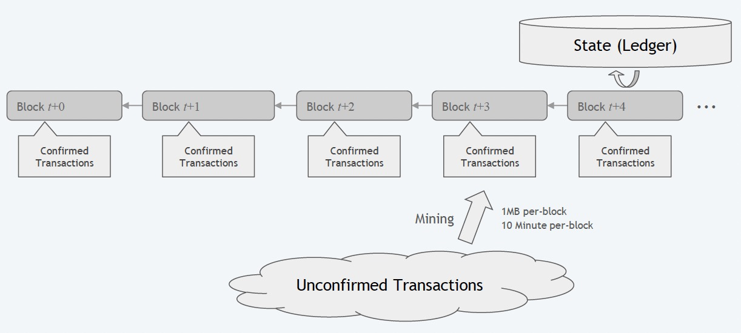
Background & Problem
Consensus: PoW
Communication
Storage
Representation
Every single node is required to
replicate ← Network I/O Bound
validate ← CPU Bound
store ← Disk I/O Bound
all transactions.
Every single node is required to
maintain states ← Memory Bound
of all users in entire network.

Slide 3
Motivation
A scalable blockchain system needs to consider the scalability of its consensus protocol with the resource usage of communication, storage, computation and memory for state representation while preserving decentralization and security.
Sharding offers a new way to improve scalability of blockchain.

Slide 4
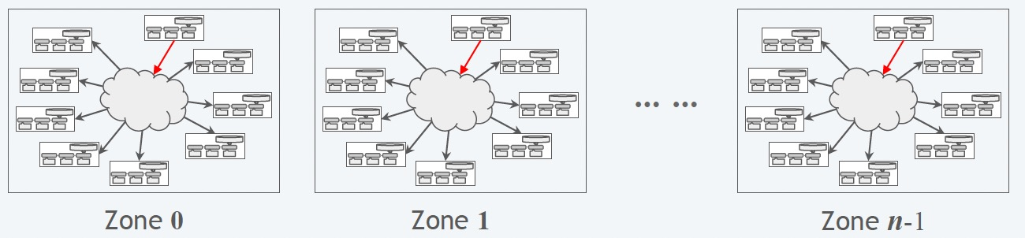
Solution & Challenge & Technique
Asynchronous Consensus Zones is the main idea in this paper, which aims to design a scalable blockchain system without weakening decentralization or security. We scale out blockchain systems by partitioning and handling workloads in multiple independent and parallel instances, or Consensus Zones.

Slide 5
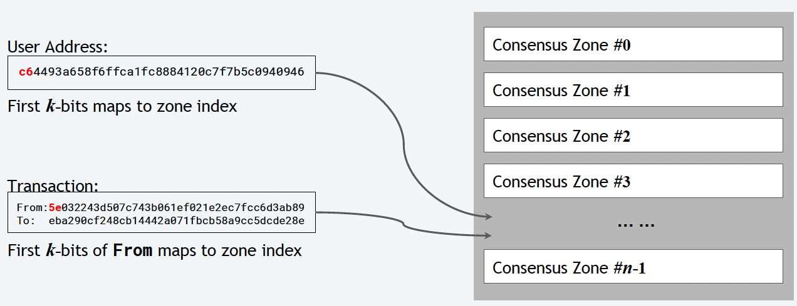
Solution & Challenge & Technique
Asynchronous Consensus Zones is the main idea in this paper, which aims to design a scalable blockchain system without weakening decentralization or security. We scale out blockchain systems by partitioning and handling workloads in multiple independent and parallel instances, or Consensus Zones.
Zone Count: n=2^k

Slide 6
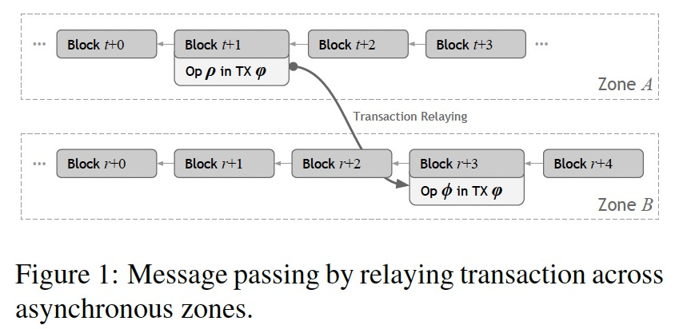
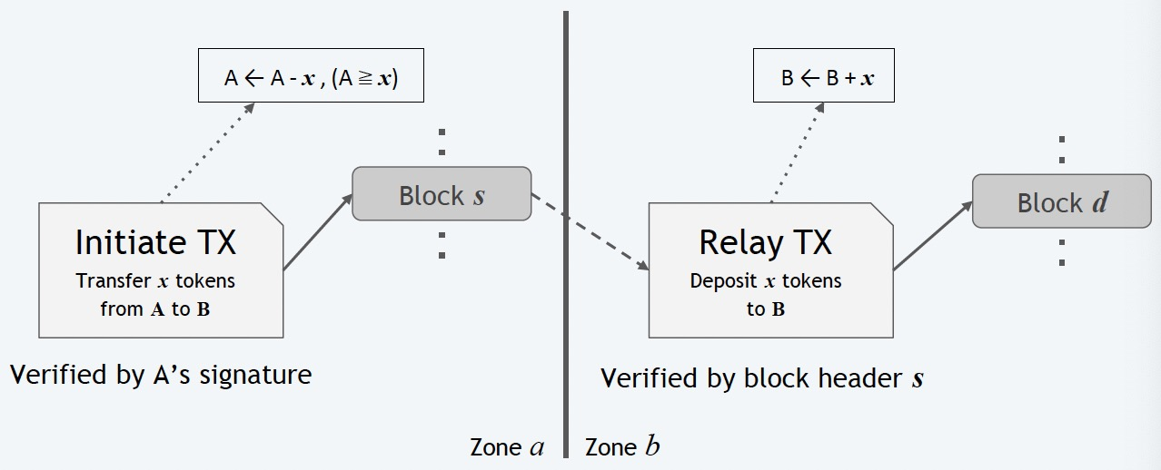
Solution & Challenge & Technique
Challenge1: high throughput should be ensured in a scalable fashion when handling cross-zone transactions.
Technique1: Cross-Zone Atomicity. Eventual atomicity decouples a cross-zone transaction into multiple steps (relay transactions), each involves a single zone. Those steps are relayed and executed across zones by miners.

Slide 7
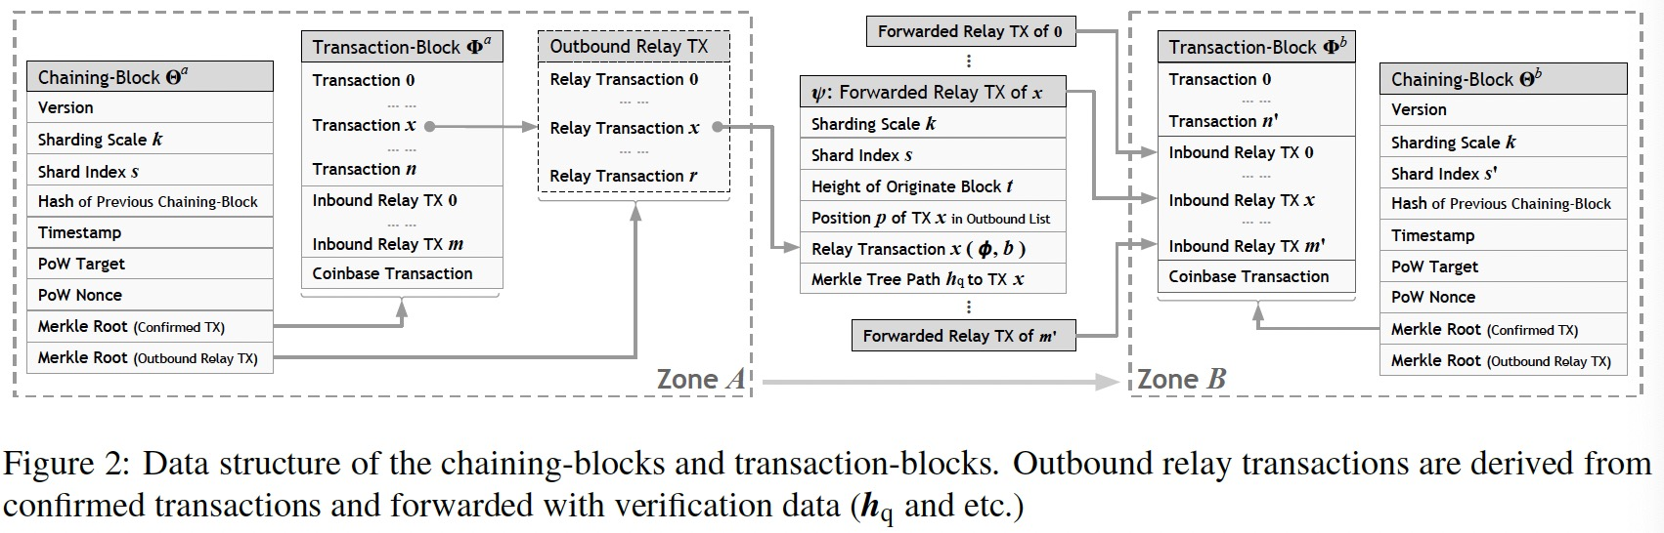
Solution & Challenge & Technique
Challenge1: high throughput should be ensured in a scalable fashion when handling cross-zone transactions.
Technique1: Cross-Zone Atomicity. Eventual atomicity decouples a cross-zone transaction into multiple steps (relay transactions), each involves a single zone. Those steps are relayed and executed across zones by miners.

Slide 8
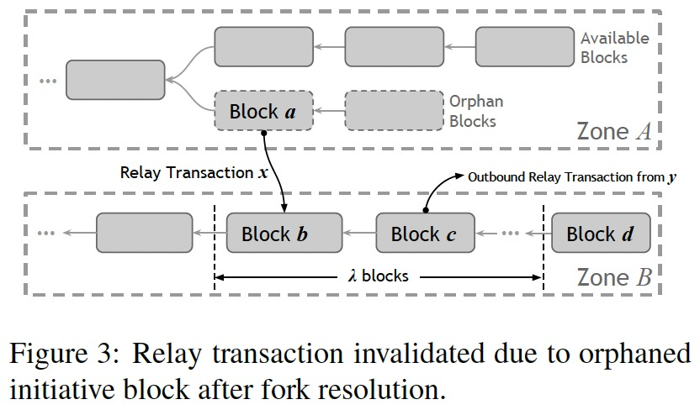
Solution & Challenge & Technique
Challenge1: high throughput should be ensured in a scalable fashion when handling cross-zone transactions.
Technique1: Cross-Zone Atomicity. Eventual atomicity decouples a cross-zone transaction into multiple steps (relay transactions), each involves a single zone. Those steps are relayed and executed across zones by miners.
Fork Resolution

Slide 9
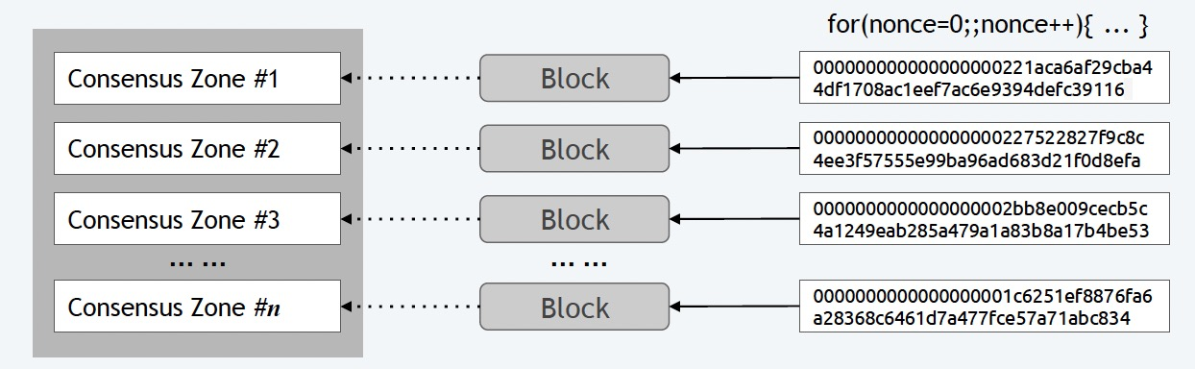
Solution & Challenge & Technique
Challenge2: security should be reinforced as honest mining power diluted due to independent growths of chains in individual zones.
Technique2: Effective Mining Power Amplification. With Chu-ko-nu mining, a miner is allowed to create multiple blocks in different zones by solving one proof-of-work puzzle. This greatly amplifies the effective mining power of honest miners who evenly distribute the mining power across zones.

Slide 10
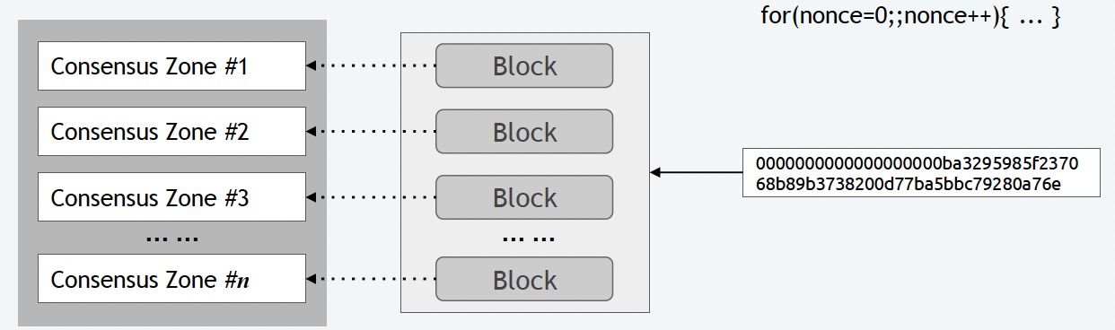
Solution & Challenge & Technique
Challenge2: security should be reinforced as honest mining power diluted due to independent growths of chains in individual zones.
Technique2: Effective Mining Power Amplification. With Chu-ko-nu mining, a miner is allowed to create multiple blocks in different zones by solving one proof-of-work puzzle. This greatly amplifies the effective mining power of honest miners who evenly distribute the mining power across zones.

Slide 11
Evaluation Results
Setup
Playback ERC20 historical payment transactions :16.5 M Addresses ,75.8 M Transactions
We deploy our system on a distributed environment that includes 1,200 virtual machines, each of which has 8 cores and 32GB memory. These machines are uniformly distributed in 15 Availability Zones for testing cross-country latency in the real world. In the test network, we restrict the end-to-end peek bandwidth to 30Mbps and the measured average end-to-end latency is 102.48 msec. In every zone, we set a 32KB limit for the block size and a target of 15-second block creation interval, which yields around 15.6 TPS for one-to-one token transfer. On such a testbed, we support 48,000 nodes of blockchain in our system.

Slide 12
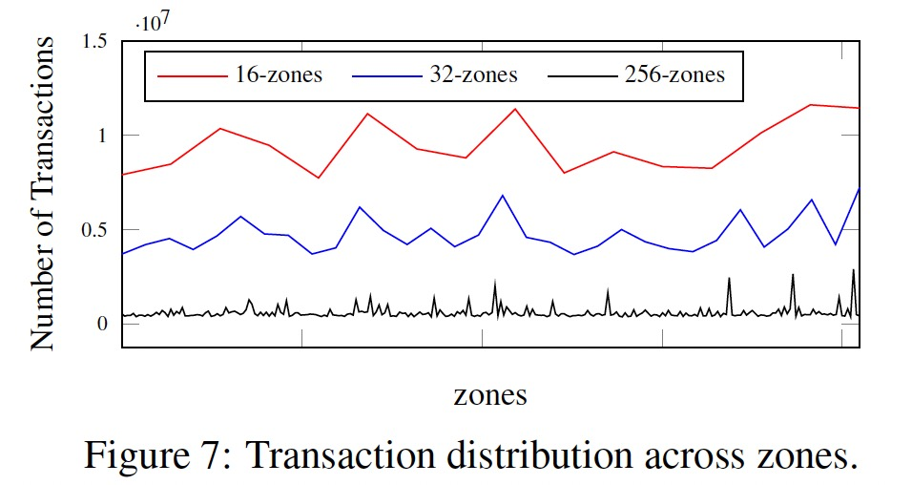
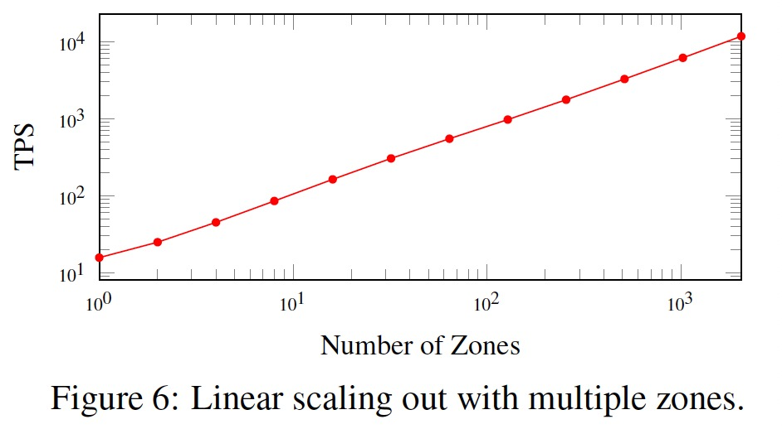
Evaluation Results
Scalability

Slide 13
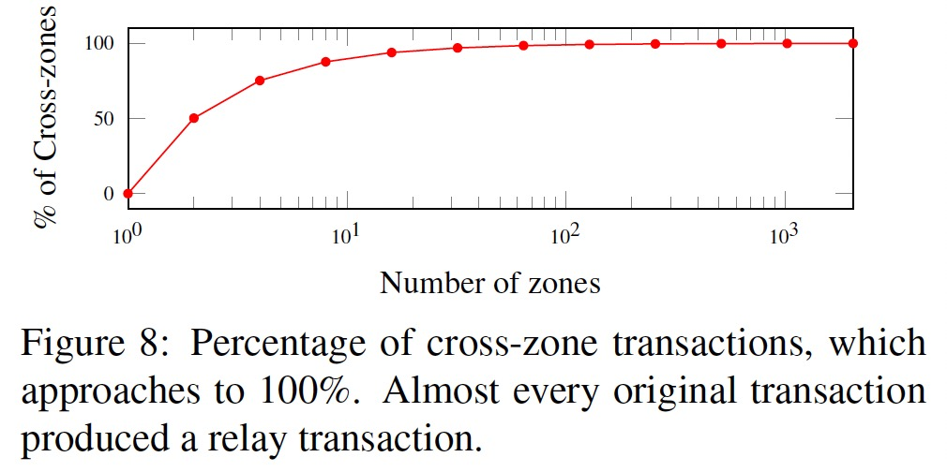
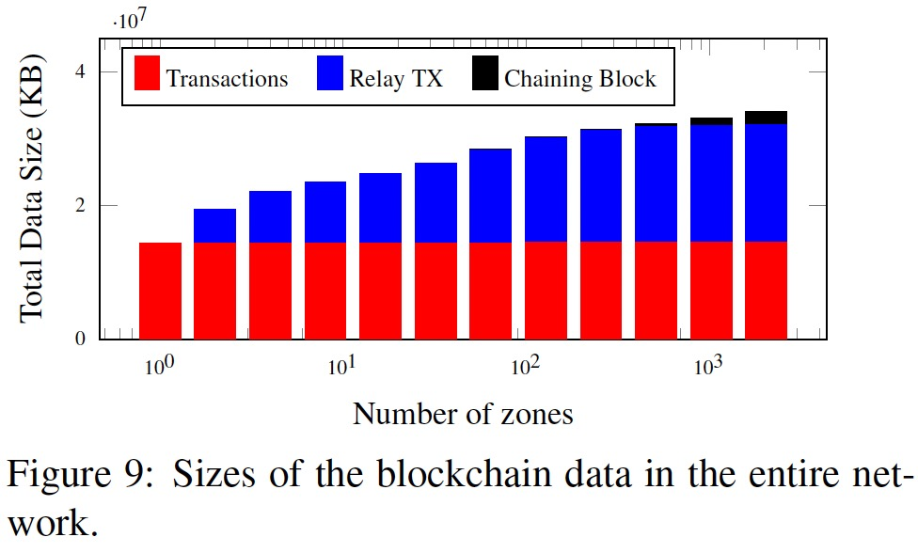
Evaluation Results
Overhead

Slide 14
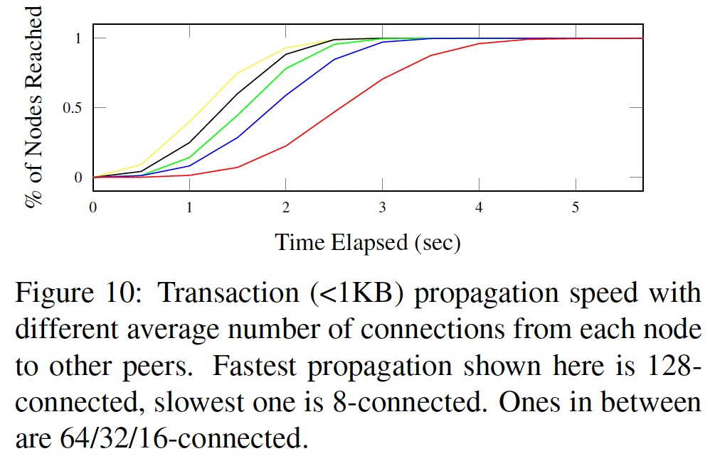
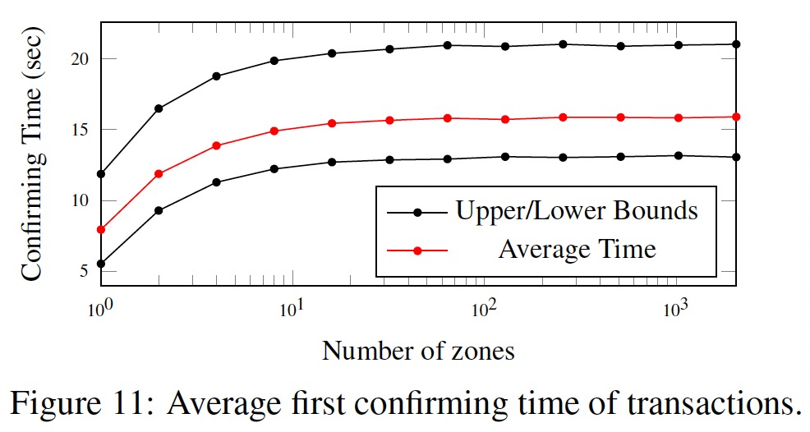
Evaluation Results
Confirmation Latency

Slide 15
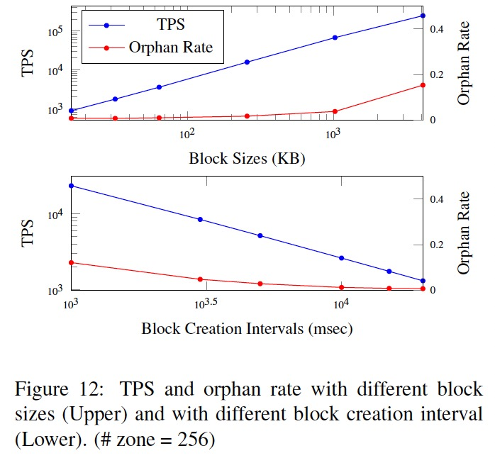
Evaluation Results
Throughput and Orphan Rate

Slide 16
Conclusion
Sharding
1. Network Sharding
2. Transaction Sharding
The transactions of whole network are divided into different fragments for verification and packaging.
3. State Sharding
The state of the complete ledger is stored separately in each shard.
Problem
1. 51% attack in POW consensus
2. Additional overhead for cross-chip communication
3. Single point overheating problem
4. Dynamic adjustment of system state caused by changes in the number of shards and nodes

